Slide 1
ICT407: IT Governance in Organisations
Week 10:
Lecturer: Dr. Farshid Keivanian

Slide 2
Introduction to Big Data and Analytics
Introduction
Big Data is a term used to describe large sets of structured, semi-structured, and unstructured data that can be analyzed for insights. Analytics refers to the techniques used to process and interpret data. The 3 Vs of Big Data are:

Slide 3
Introduction to Big Data and Analytics
Volume: Large quantity of data.
Velocity: Speed at which data is processed.
Variety: Different types of data, such as text, images, videos.

Slide 4
Introduction to Big Data and Analytics
Practical Scenario:
Imagine you are working for a logistics company in Sydney. Your company collects data from thousands of trucks traveling across Australia daily. Each truck sends location data, fuel consumption, and delivery times. However, the data is massive and comes in various formats—text, images, and GPS coordinates. You need to make sense of this data.
Discussion Question: How can using Big Data analytics improve the efficiency of your company’s operations?

Slide 5
Introduction to Big Data and Analytics
Response: By analyzing the data, you can optimize delivery routes, reduce fuel consumption, and predict maintenance needs for trucks.
Multiple-Choice Question:
What are the three Vs of Big Data?
A) Volume, Variety, and Value B) Volume, Velocity, and Visualization
C) Volume, Velocity, and Variety

Slide 6
Types of Data Analytics
Introduction:
Data analytics is divided into several types:
Descriptive Analytics: What happened?
Diagnostic Analytics: Why did it happen?
Predictive Analytics: What will happen?
Prescriptive Analytics: What should we do about it?

Slide 7
Types of Data Analytics
Practical Scenario:
You work for a retail company in Melbourne. Last year’s sales dropped unexpectedly during the holiday season. You’ve been tasked with analyzing historical sales data to understand the cause and predict next year's sales.
Discussion Question: Which type of analytics would you use to find the root cause of last year’s sales drop, and which type would you use to predict future sales?

Slide 8
Types of Data Analytics
Response: Use Diagnostic Analytics to find out why sales dropped and Predictive Analytics to forecast next year’s sales trends.
Multiple-Choice Question:
Which type of analytics explains why something happened?
A) Diagnostic
B) Descriptive C) Predictive

Slide 9
AI in Customer Service
Introduction:
Artificial Intelligence (AI) automates tasks by mimicking human intelligence. In customer service, AI can be used to handle inquiries and resolve issues through chatbots.

Slide 10
AI in Customer Service
Practical Scenario:
You are the IT manager for a telecom company in Brisbane. You’ve implemented an AI chatbot to handle customer inquiries. The chatbot can answer basic questions, such as "What is my data balance?" or "How can I pay my bill?"
Discussion Question: How can implementing AI improve your company's customer service experience?

Slide 11
AI in Customer Service
Response: AI can provide faster responses to common customer inquiries, reduce wait times, and allow customer service agents to focus on more complex issues.
Multiple-Choice Question:
What type of AI is used to handle customer inquiries via chatbots?
A) General AI B) Narrow AI C) Diagnostic AI

Slide 12
Blockchain Technology
Introduction:
Blockchain is a decentralized technology used to secure transactions without the need for a central authority. It ensures security, transparency, and auditability.

Slide 13
Blockchain Technology
Practical Scenario:
Your company in Canberra is considering using blockchain to track the supply chain of goods. Every product's movement—from manufacturing to delivery—will be recorded on the blockchain, ensuring that no data is tampered with.
Discussion Question: How can blockchain enhance the transparency and security of your company’s supply chain?

Slide 14
Blockchain Technology
Response: Blockchain ensures that every transaction in the supply chain is recorded and cannot be altered, providing full transparency and preventing fraud.
Multiple-Choice Question:
Which feature of blockchain ensures that once a transaction is recorded, it cannot be altered?
A) Decentralization B) Persistency C) Anonymity

Slide 15
IoT (Internet of Things) Governance
Introduction:
The Internet of Things (IoT) connects physical devices like sensors, vehicles, and appliances, allowing them to communicate and exchange data.

Slide 16
IoT (Internet of Things) Governance
Practical Scenario:
You work for a smart home company in Sydney that connects various devices in a customer’s house, such as lights, thermostats, and security cameras. You need to ensure that the data collected by these devices is secure and managed properly.
Discussion Question: What are the key governance concerns when dealing with IoT data in smart homes?

Slide 17
IoT (Internet of Things) Governance
Response: Privacy, data ownership, and data security are crucial governance concerns when managing IoT data in smart homes.
Multiple-Choice Question:
What is a key governance issue for IoT?
A) Device ownership B) Device variety
C) Data privacy and security

Slide 18
Data Cleaning
Data cleaning is a foundational step before any analytics can occur. Dirty data (missing, incorrect, or duplicated values) can lead to poor business decisions.
This code focuses on data cleaning, which is an essential part of Big Data analytics and IT governance, as it ensures that data is accurate, standardized, and ready for analysis.

Slide 19
Data Cleaning
Code Explanation:
Step 1: Missing values are identified using isnull().
Step 2: Importance of removing duplicate rows and standardizing formats.
Step 3: Dates are standardized using pd.to_datetime().
Step 4: Rows with NaN values in critical columns are removed.
Data quality through governance ensures consistency, reliability, and accuracy in analytics.

Slide 20
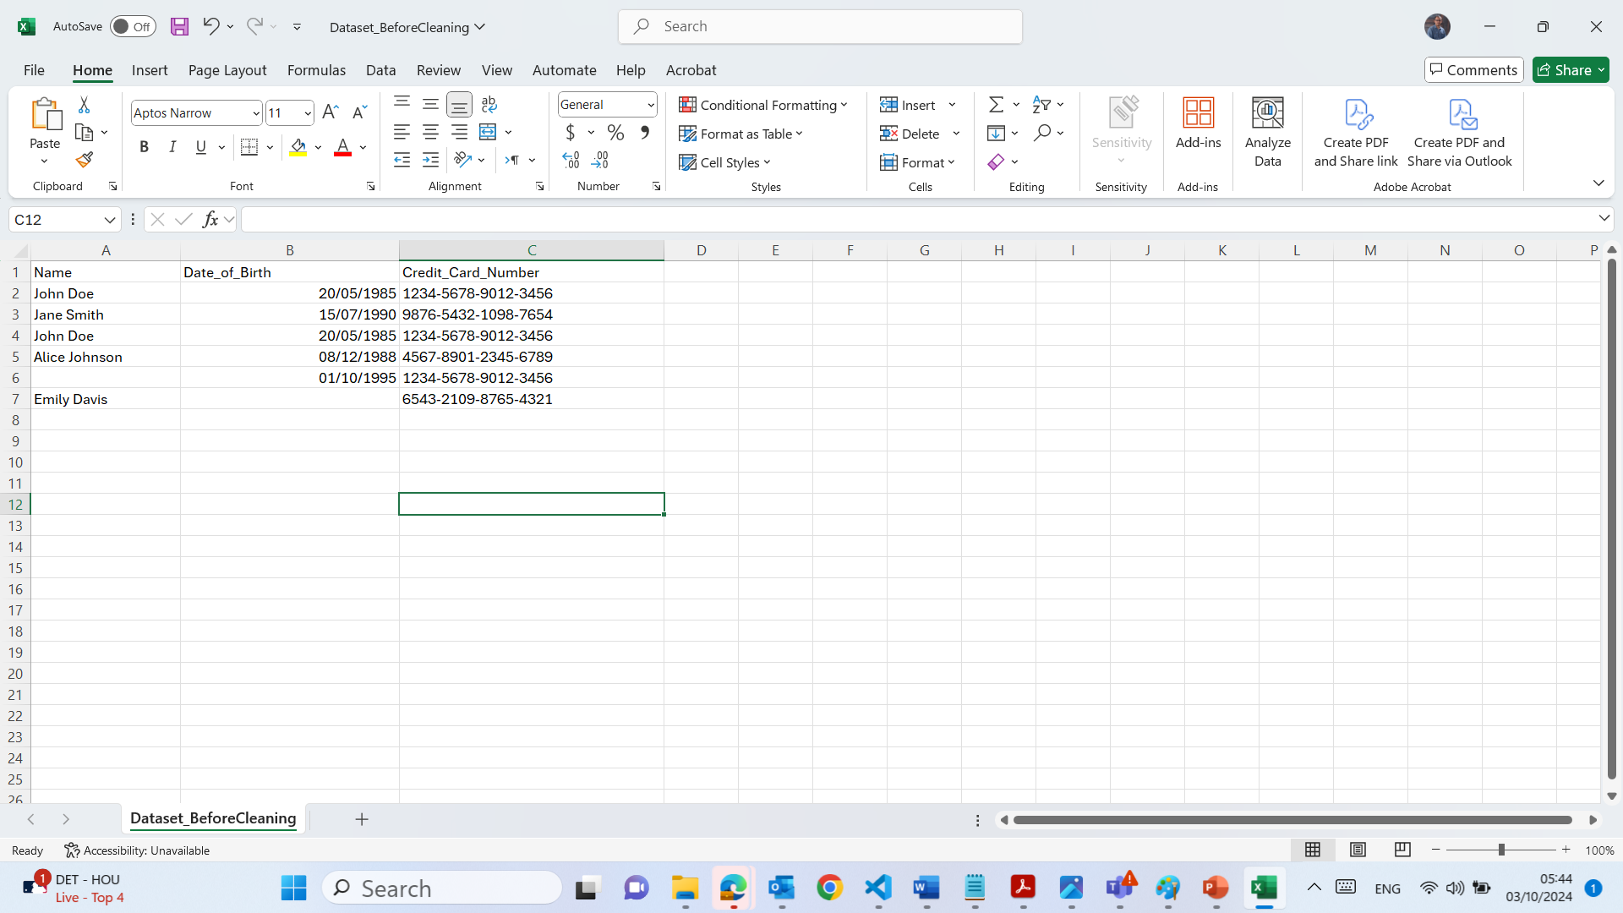
Data Handling and Cleaning Techniques - DataCleanerPro

Slide 21
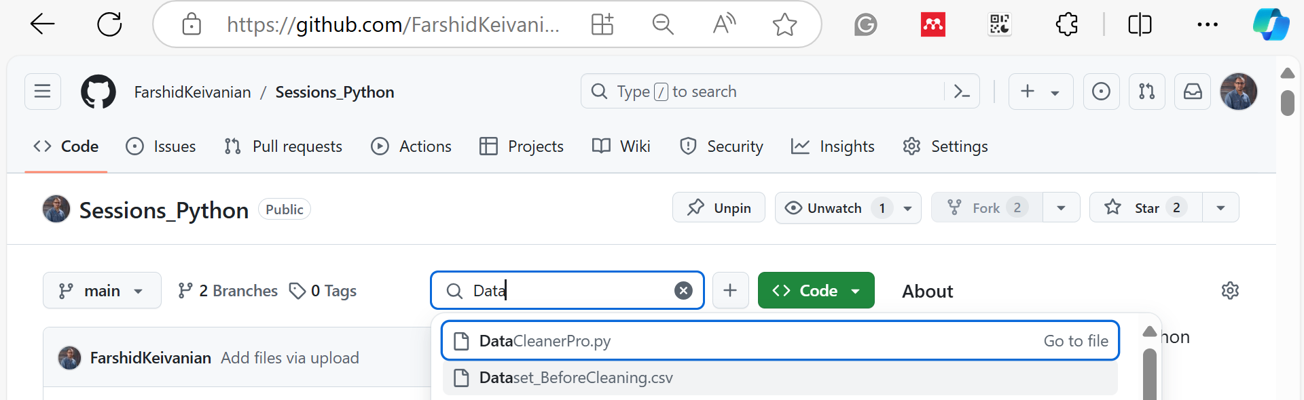
Data Handling and Cleaning Techniques - DataCleanerPro
DataCleanerPro Code covers all the steps of data cleaning: identifying missing values, removing duplicates, standardizing data formats, and removing NaN values.

Slide 22
Data Handling and Cleaning Techniques - DataCleanerPro
import pandas as pd
import numpy as np
# Use the Same Folder for data and code
# Load the dataset
df = pd.read_csv('Dataset_BeforeCleaning.csv')
# Display the original data
print("=== Original Data ===")
print(df)
# Step 1: Identifying Missing Values (Before Cleaning)
print("\n=== Step 1: Identifying Missing Values (Before Cleaning) ===")
print(df.isnull().sum())

Slide 23
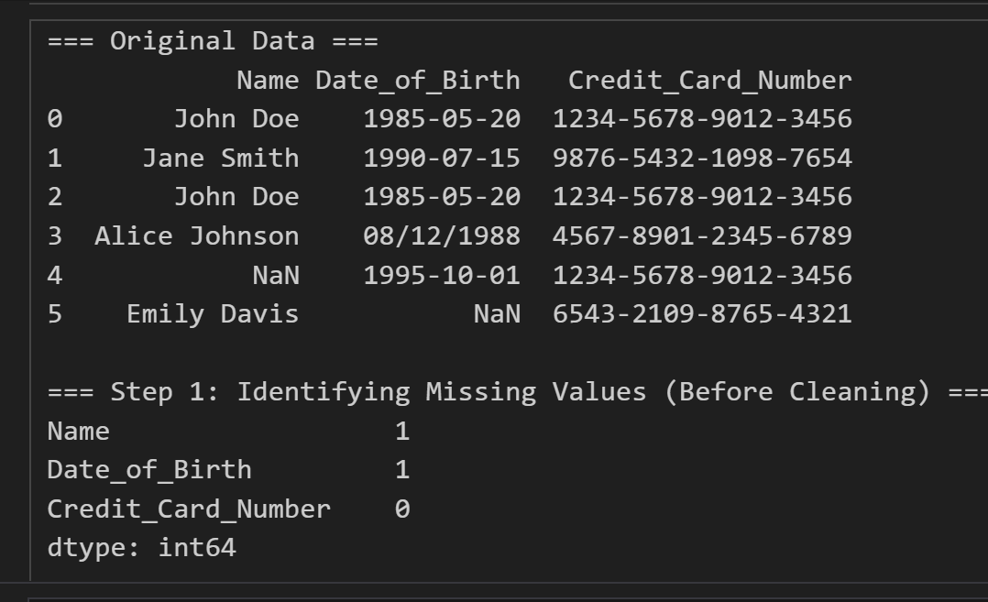
Data Handling and Cleaning Techniques - DataCleanerPro

Slide 24
Data Handling and Cleaning Techniques - DataCleanerPro
# Step 1: Display the data before removing duplicates
print("\n=== Data Before Removing Duplicates ===")
print(df)
# Step 2: Remove duplicates
df_no_duplicates = df.drop_duplicates()
# Step 2: Display the data after removing duplicates
print("\n=== Step 2: Data After Removing Duplicates ===")
print(df_no_duplicates)

Slide 25
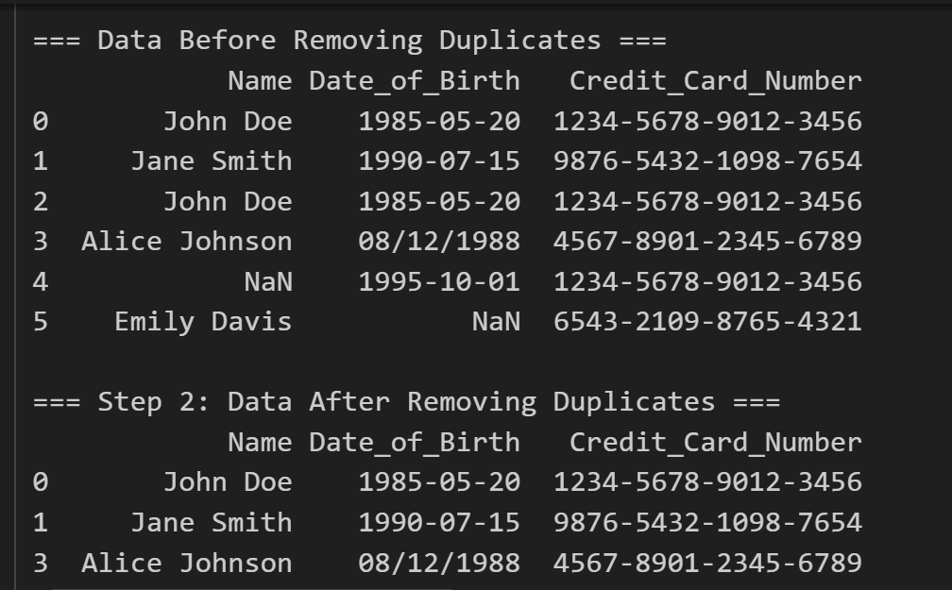

Slide 26
Data Handling and Cleaning Techniques - DataCleanerPro
# Step 3: Display the data before standardizing date formats
print("\n=== Data Before Standardizing Date Formats ===")
print(df_no_duplicates)
# Step 3: Standardizing the date format to YYYY-MM-DD
df_no_duplicates['Date_of_Birth'] = pd.to_datetime(df_no_duplicates['Date_of_Birth'], format='%m/%d/%Y', errors='coerce').fillna(
pd.to_datetime(df_no_duplicates['Date_of_Birth'], errors='coerce')).dt.strftime('%Y-%m-%d')
# Step 3: Display the data after standardizing the date format
print("\n=== Step 3: Data After Standardizing Date Format ===")
print(df_no_duplicates)

Slide 27
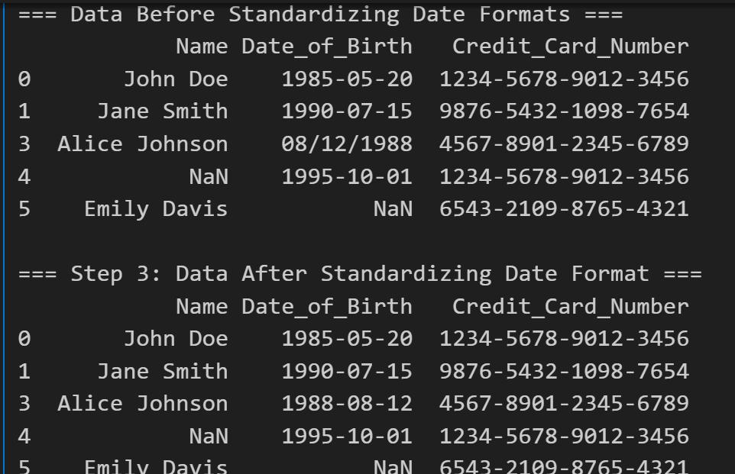

Slide 28
Data Handling and Cleaning Techniques - DataCleanerPro
The best action for handling NaN values depends on the context and the nature of the dataset. Here's how to decide between the options:
1. Removing Rows with NaN Values:
When to Use: If the dataset is large and the number of rows with NaN values is small, or if the missing data is genuinely not crucial for analysis, you might choose to remove those rows.
Advantages: Simple and effective, especially if missing values are minimal.
Disadvantages: You lose some data, which might impact the analysis if many rows have missing values.

Slide 29
Data Handling and Cleaning Techniques - DataCleanerPro
2. Replacing with Mean/Median/Mode:
When to Use: This approach is suitable when the data is numerical or categorical, and NaN values are not extensive. It helps retain the dataset's size without introducing significant bias.
Mean: Use for numerical data that’s normally distributed (e.g., ages or income).
Median: Use when the data contains outliers or is skewed.
Mode: Use for categorical data (e.g., names, gender, etc.)
Advantages: Maintains the dataset size and works well when missing data points are randomly distributed.
Disadvantages: Can introduce bias, especially if the mean/median/mode doesn't represent the missing data accurately.

Slide 30
Data Handling and Cleaning Techniques - DataCleanerPro
# Step 4: Display the data before removing NaN values
print("\n=== Step 4: Data Before Removing NaN Values ===")
print(df_no_duplicates)
# Step 4: Remove rows where 'Name' or 'Date_of_Birth' is NaN
df_no_duplicates = df_no_duplicates.dropna(subset=['Name', 'Date_of_Birth'])
# Step 4: Display the data after removing NaN values
print("\n=== Step 4: Data After Removing NaN Values ===")
print(df_no_duplicates)
# Save the cleaned data to a new CSV file
df_no_duplicates.to_csv('Dataset_AfterCleaning.csv', index=False)

Slide 31
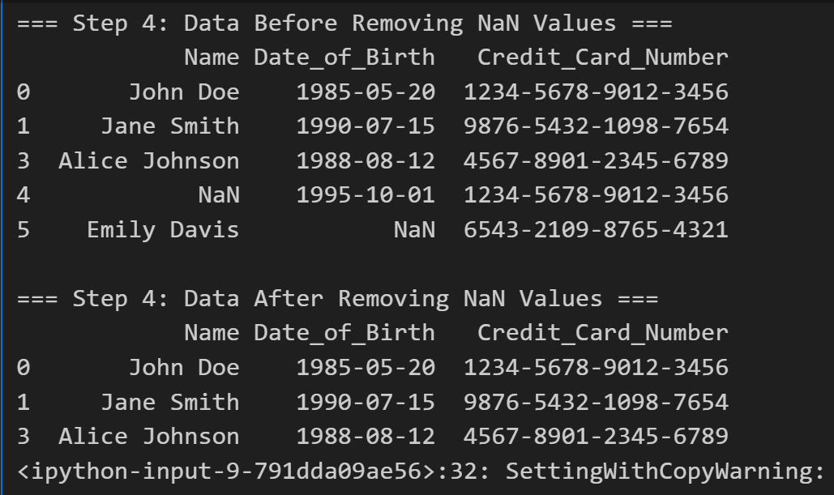

Slide 32
IT Governance for Data Analytics
Introduction:
IT Governance is critical in managing the flow of data analytics results, ensuring data quality, and eliminating redundancies.

Slide 33
IT Governance for Data Analytics
Practical Scenario:
Your company in Melbourne is rolling out a new data analytics system. Without proper IT governance, the data might become disorganized, and valuable insights could be lost.
Discussion Question: Why is IT governance important for data analytics in an organization?

Slide 34
IT Governance for Data Analytics
Response: IT governance ensures that data analytics processes are aligned with business goals, improves data accessibility, and ensures data is not duplicated or lost.
Multiple-Choice Question:
What does IT governance in data analytics help to prevent?
A) High data velocity B) Data redundancy and disorganization C) Data variety

Slide 35
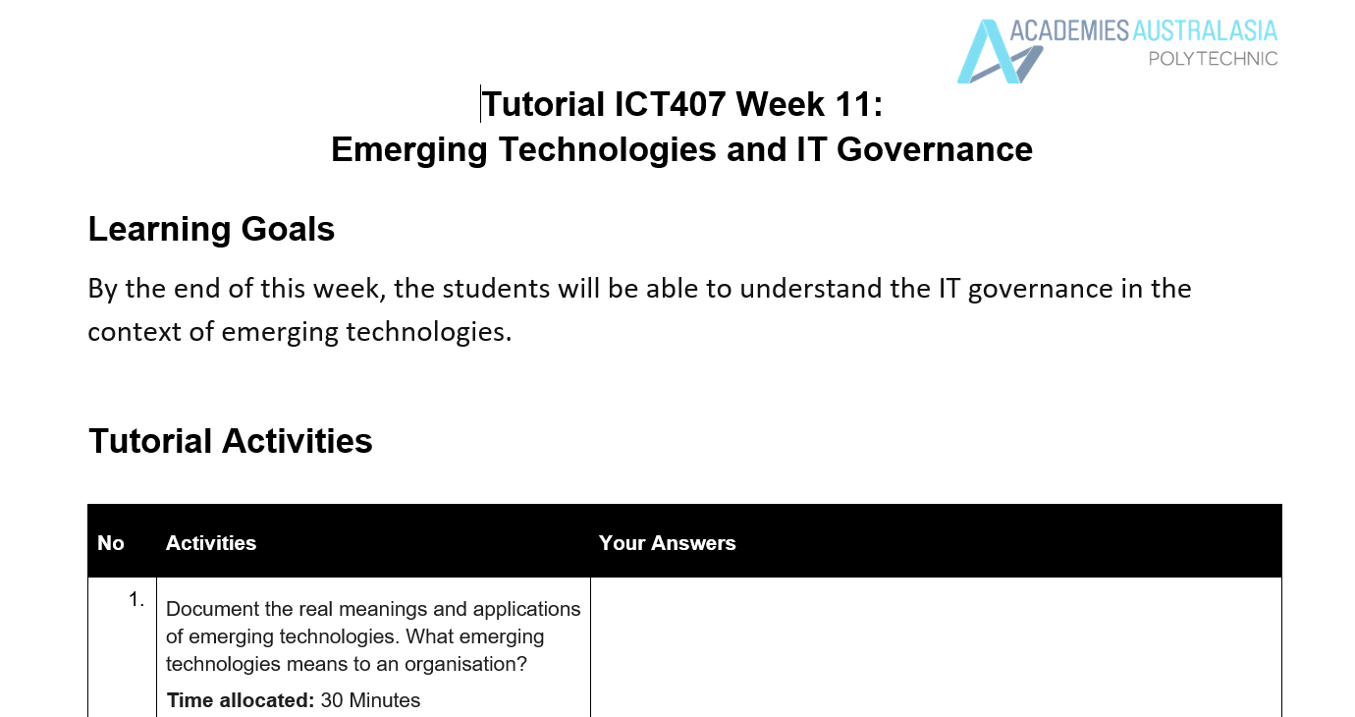
Tutorial Week 11

Slide 36
Tutorial Week 11
Emerging Technologies: Real Meanings and Applications
Emerging technologies refer to novel, innovative tools, processes, or solutions that are in the early stages of adoption or development. These technologies often have the potential to significantly impact industries, create new markets, and change the way organizations operate. Some key emerging technologies include Artificial Intelligence (AI), Blockchain, Internet of Things (IoT), Big Data Analytics, and 5G.

Slide 37
Tutorial Week 11
Real Meanings and Applications of Key Emerging Technologies:
Artificial Intelligence (AI):
Meaning: AI refers to the simulation of human intelligence in machines. These systems can learn, reason, and make decisions.
Application: AI is used in industries such as healthcare for disease diagnosis, finance for fraud detection, and customer service through chatbots.
Blockchain:
Meaning: Blockchain is a decentralized digital ledger technology where transactions are securely recorded across multiple computers.
Application: Blockchain is used in supply chain management to ensure transparency and in financial transactions for secure payments and smart contracts.

Slide 38
3. Internet of Things (IoT):
Meaning: IoT refers to the network of connected devices that communicate with each other and exchange data.
Application: IoT is widely used in smart homes, connected cars, and industrial automation for better decision-making through data collection.
4. Big Data Analytics:
Meaning: This involves analyzing vast volumes of data to extract meaningful insights and patterns.
Application: Big Data is used by organizations to optimize business processes, improve customer service, and make data-driven decisions.

Slide 39
5G:
Meaning: 5G is the fifth-generation mobile network technology that offers faster speeds, lower latency, and greater connectivity.
Application: 5G enables advancements in IoT, smart cities, autonomous vehicles, and real-time data analytics.

Slide 40
What Emerging Technologies Mean to an Organization
For organizations, emerging technologies represent:
Competitive Advantage: Staying ahead by adopting innovative solutions to improve efficiency, customer satisfaction, and market reach.
Improved Decision-Making: Leveraging AI, Big Data, and IoT for better insights, predictions, and automation.
Operational Efficiency: Using technologies like AI and automation to streamline processes, reduce costs, and minimize errors.

Slide 41
Enhanced Customer Experience: Personalizing customer interactions, providing faster services, and offering innovative products.
Risk Management: Implementing cybersecurity and blockchain technologies to improve data security, privacy, and governance.
IT Governance: Organizations must align emerging technologies with business strategies and policies, ensuring they follow compliance and regulatory standards.

Slide 42
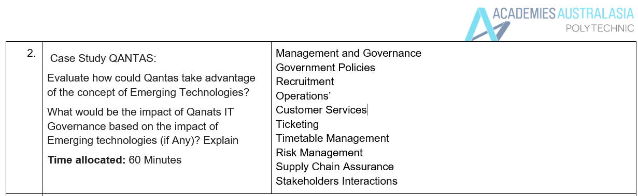

Slide 43
Case Study: Qantas and Emerging Technologies
Qantas is Australia’s largest airline, with a reputation for innovation and excellent customer service. As the airline industry becomes more digitalized, Qantas has opportunities to leverage emerging technologies to enhance its operations, customer experience, and competitiveness.
How Could Qantas Take Advantage of Emerging Technologies?
Artificial Intelligence (AI):
Applications: Qantas could implement AI in areas like predictive maintenance for its aircraft, ensuring that planes are serviced before any issues arise. AI-powered chatbots can provide 24/7 customer service, handling bookings, flight information, and complaints more efficiently.
Impact: This would reduce operational costs, improve customer satisfaction, and enhance safety.

Slide 44
3. Internet of Things (IoT):
Applications: Qantas can utilize IoT sensors in its aircraft to monitor the performance of engines, fuel efficiency, and other critical components in real-time. Additionally, IoT devices can track luggage or provide personalized services to passengers, such as monitoring in-flight entertainment preferences.
Impact: IoT would improve operational efficiency, reduce flight delays, and enhance the overall passenger experience.
4. Big Data Analytics:
Applications: Qantas can use Big Data to analyze customer behavior and tailor marketing campaigns, flight schedules, and service offerings. Analytics can also predict future travel trends and optimize pricing strategies based on customer demand.
Impact: Big Data can help Qantas make data-driven decisions, optimize flight routes, and offer personalized services, improving both revenue and customer loyalty.

Slide 45
4. Blockchain:
Applications: Qantas could explore blockchain for secure and transparent ticketing systems, ensuring fraud prevention and customer privacy. Additionally, blockchain could streamline supply chain management for the airline’s maintenance parts and logistics.
Impact: Blockchain could offer greater transparency, security, and efficiency in Qantas' financial and operational processes.
5. 5G:
Applications: With faster internet speeds, Qantas can improve its in-flight connectivity services for passengers, offering seamless streaming, real-time communication, and data usage. 5G would also enhance its IoT infrastructure, enabling real-time monitoring of aircraft systems.
Impact: Passengers will have a better travel experience, and operational efficiency will improve through real-time data exchange between aircraft and ground control.

Slide 46
Impact of Emerging Technologies on Qantas’ IT Governance
As Qantas integrates these emerging technologies, there will be significant impacts on its IT governance framework, which includes the policies, processes, and regulations that guide IT decision-making and operations.
Data Security & Privacy:
With the use of IoT, AI, and Big Data, there will be a significant increase in the volume of sensitive data collected (e.g., passenger details, flight operations). Qantas must ensure that IT governance policies are updated to maintain compliance with data protection laws, especially under the Australian Privacy Principles (APPs).

Slide 47
2. Operational Risk Management:
As AI and automation are implemented, Qantas' IT governance must establish guidelines to mitigate risks such as system errors, cyber-attacks, and unexpected technological failures.
3. Regulatory Compliance:
Emerging technologies will require Qantas to ensure regulatory compliance, particularly regarding data handling, financial transactions (via blockchain), and safety protocols for IoT and AI-powered systems. IT governance must work closely with regulatory bodies to ensure adherence to aviation safety standards.

Slide 48
4. Decision-Making:
AI and Big Data analytics will offer Qantas real-time insights into its operations and market trends. IT governance must establish clear policies on how these insights are used to make data-driven decisions across the organization.
5. Innovation vs. Risk:
As Qantas adopts more emerging technologies, its IT governance must strike a balance between fostering innovation and managing associated risks. Governance policies should encourage safe experimentation with new technologies while protecting critical operations and customer data.

Slide 49
Conclusion
Emerging technologies like AI, Blockchain, IoT, Big Data Analytics, and 5G offer Qantas numerous opportunities to enhance operational efficiency, improve customer service, and stay competitive in the airline industry. However, with these benefits come challenges related to IT governance. Ensuring robust governance is in place to manage data privacy, security, compliance, and risk will be critical as Qantas continues to leverage these technologies.

Slide 50
Class Group Activity: Presenting Emerging Technologies & IT Governance
For this group activity, each group will select one question or topic from the provided lecture and tutorial content and prepare a PowerPoint presentation. The objective is for each group to present the key concepts they have learned, demonstrate their understanding of how emerging technologies are applied in real-world scenarios, and analyze their impact on IT governance.
Each group will present their findings to the class and facilitate a brief discussion.

Slide 51
Group Activity Structure:
Introduction: Each group introduces their chosen concept and provides a brief explanation of the key terms.
Scenario: Groups present a practical scenario related to the concept and explain how it applies in a specific industry or organization.
Discussion: Each group presents a discussion question to the class, engages the audience, and facilitates responses.
Impact on IT Governance: Groups explain how the emerging technology affects IT governance in terms of compliance, data security, and decision-making.
PowerPoint Presentation: Groups prepare 4-5 slides to visually present their chosen topic, scenario, and discussion.
Q&A Session: Groups open the floor to any questions from the class and provide clarifications.

Slide 52
Topic 1: Big Data and Analytics
Key Concept: Big Data is characterized by its Volume, Velocity, and Variety, requiring sophisticated analytics to derive insights.
Practical Scenario: Your group works for a logistics company in Sydney that uses Big Data analytics to optimize delivery routes and reduce costs.
Discussion Question: How can the 3 Vs of Big Data improve operational efficiency in logistics?
Impact on IT Governance: IT Governance will need to ensure proper data management, security, and compliance to handle the growing volume and complexity of data.

Slide 53
Topic 1: Big Data and Analytics
Key Concept: Big Data is characterized by its Volume, Velocity, and Variety, requiring sophisticated analytics to derive insights.
Practical Scenario: Your group works for a logistics company in Sydney that uses Big Data analytics to optimize delivery routes and reduce costs.
Discussion Question: How can the 3 Vs of Big Data improve operational efficiency in logistics?
Impact on IT Governance: IT Governance will need to ensure proper data management, security, and compliance to handle the growing volume and complexity of data.

Slide 54
Topic 2: Types of Data Analytics
Key Concept: Data analytics is divided into descriptive, diagnostic, predictive, and prescriptive analytics, each serving a different purpose in decision-making.
Practical Scenario: You work for a retail company in Melbourne that uses predictive analytics to forecast sales and prescriptive analytics to recommend pricing strategies.
Discussion Question: Which type of analytics would your company use to understand why sales dropped last year and predict future trends?
Impact on IT Governance: IT governance will need to ensure the accuracy and integrity of data used in analytics, with proper oversight on how predictive models are applied.

Slide 55
Topic 3: AI in Customer Service
Key Concept: AI automates tasks such as customer inquiries using chatbots, improving efficiency and customer satisfaction.
Practical Scenario: Your group is an IT manager at a telecom company in Brisbane that uses AI-powered chatbots to answer customer questions about billing and services.
Discussion Question: How can implementing AI chatbots improve your company’s customer service and efficiency?
Impact on IT Governance: IT governance needs to ensure the privacy and security of customer data handled by AI systems and establish guidelines for AI decision-making.

Slide 56
Topic 4: Blockchain Technology
Key Concept: Blockchain is a decentralized technology that provides transparency, security, and persistency in transactions.
Practical Scenario: Your group represents a company in Canberra exploring the use of blockchain to track supply chain movements and prevent fraud.
Discussion Question: How can blockchain improve transparency and security in your company’s supply chain?
Impact on IT Governance: IT governance must adapt to ensure compliance with blockchain-based transactions and address challenges in securing distributed ledger systems.

Slide 57
Topic 5: IoT (Internet of Things) Governance
Key Concept: IoT involves connecting devices that collect and exchange data. Proper governance is needed to manage the data, privacy, and security concerns.
Practical Scenario: Your group is a smart home company in Sydney that manages various devices like thermostats and security cameras. Ensuring data security and privacy is a key challenge.
Discussion Question: What are the major governance challenges when managing IoT data in smart homes?
Impact on IT Governance: IT governance must ensure that data collected by IoT devices is secure, that users’ privacy is respected, and that regulatory requirements are met.

Slide 58
Topic 6: IT Governance for Data Analytics
Key Concept: IT governance is crucial in ensuring that data analytics results are aligned with business goals and that data quality is maintained.
Practical Scenario: Your company in Melbourne is launching a new data analytics system to help optimize business processes, but without proper governance, data could become disorganized.
Discussion Question: Why is IT governance critical for ensuring data analytics is effective in an organization?
Impact on IT Governance: IT governance will need to develop policies for handling the analytics system, ensuring that data flow, security, and compliance are prioritized.

Slide 59
Evaluation Criteria for Presentation:
Content Knowledge: Does the group demonstrate a clear understanding of the concept?
Application to Scenario: How well does the group apply the concept to a real-world scenario?
Class Engagement: Does the group engage the class in meaningful discussion and encourage participation?
Impact on IT Governance: Does the group effectively explain how IT governance is impacted by the technology?
Visual Presentation: Is the PowerPoint presentation clear, visually engaging, and well-organized?

Slide 60
Group Activity Tips:
Encourage the use of real-world examples from companies or industries to make the presentation more relatable.
Ensure groups explain technical terms clearly, especially for those who may need a refresher on key concepts.
Foster an interactive atmosphere where each group invites questions from the audience and facilitates discussions on the topic.
This structure will help you collaborate, engage with emerging technologies, and deepen your understanding of their impact on IT governance.

Slide 61

Thank You!

